Slide 1
Sprint 2 BOOX
Abele Amsalu - Project Manager
Jonny Martinez - Scrum Master
Camille Pascua - Programmer 1
Raheel Jooma - Programmer 2
Charlotte Owen - Quality Assurance
Notes:
Jonny - Present the people in the group

Slide 2
Purpose of the System
Search for photos/images online that are allowed to be used under current copyright laws
Store said photos onto an online database and/or locally
Notes:
Abele -

Slide 3
Concept of Technologies used
Everyone using the website gets cloud storage full of pictures they have previously searched
Photos are stored in Firebase with appropriate search terms used from Pixabay
Notes:
Jonny -

Slide 4
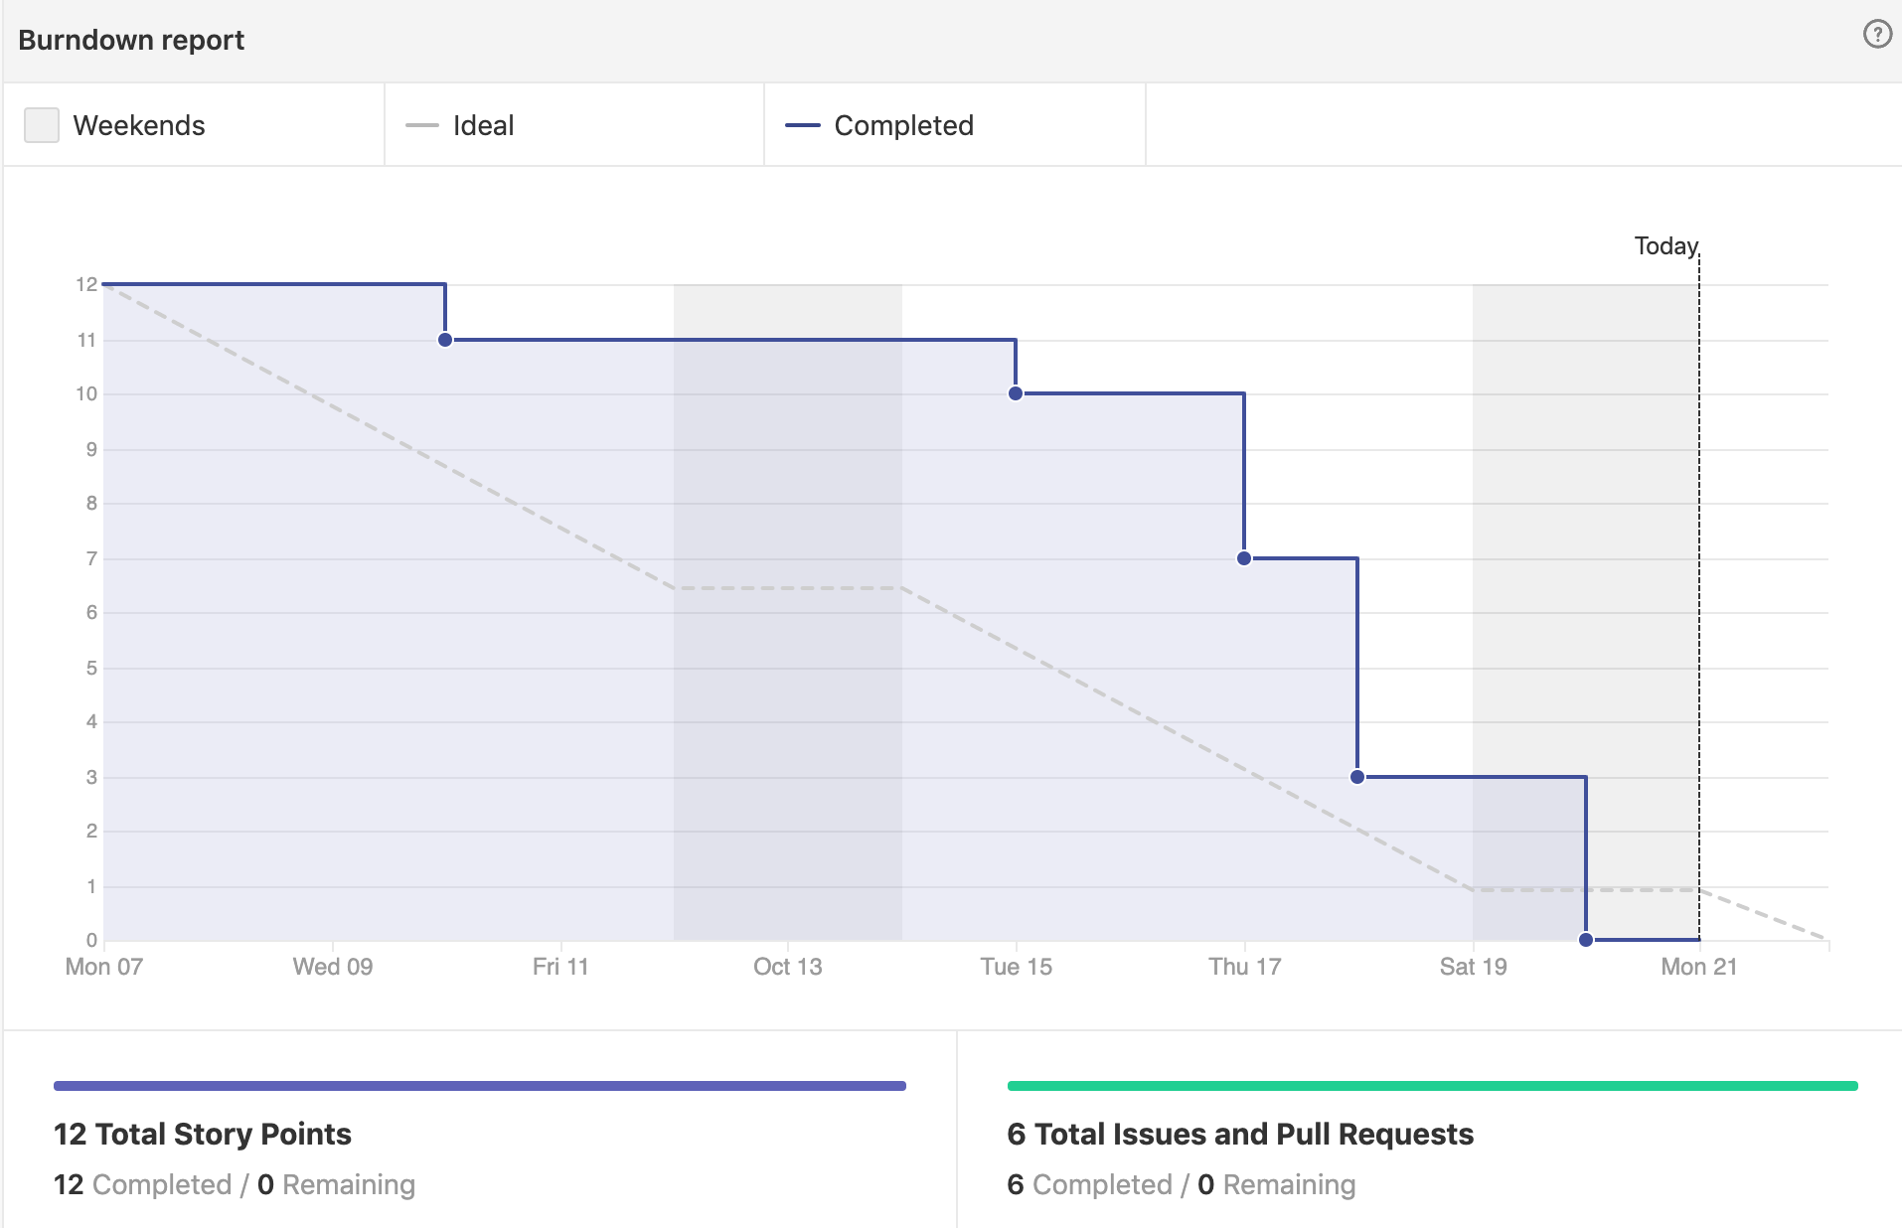
Notes:
Jonny - It’s clearly shown in the burndown chart that we got work done primarily in the second week and I think that is primarily because of midterms happening in the first week of the sprint.

Slide 5
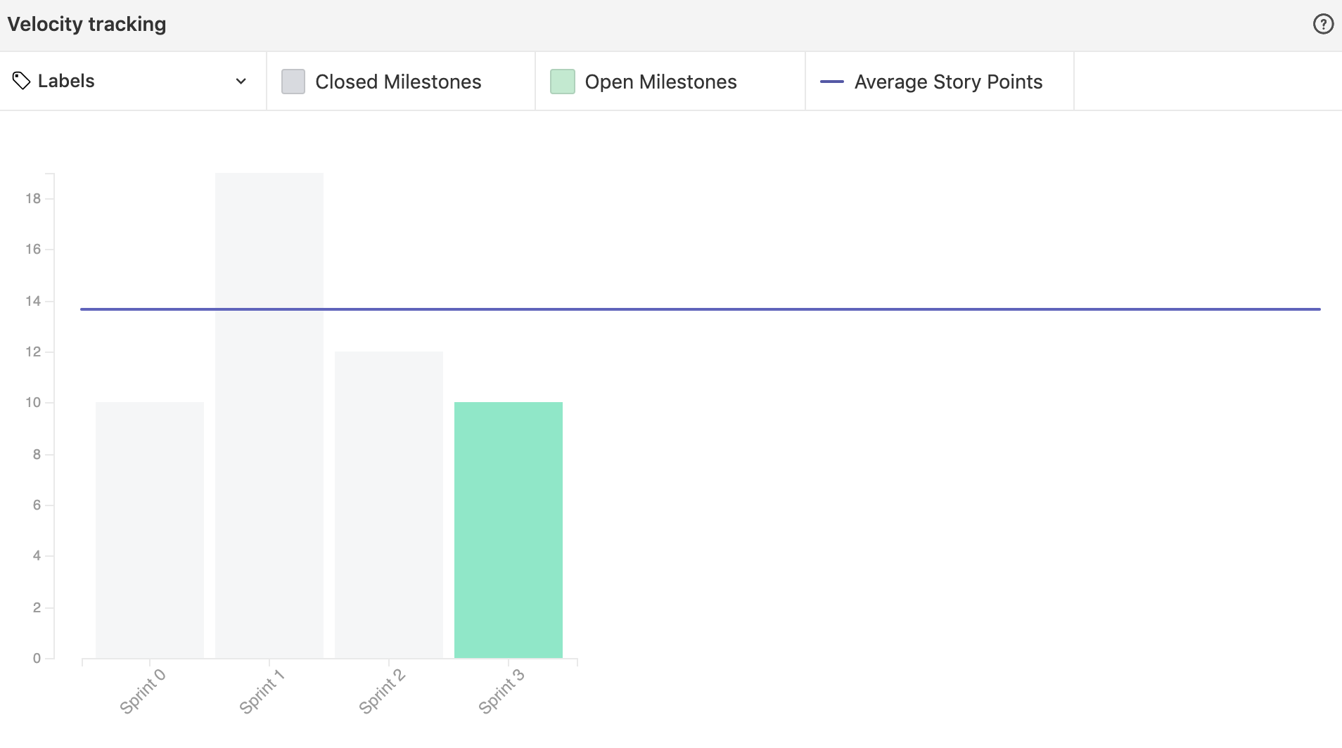
Notes:
Abele -

Slide 6
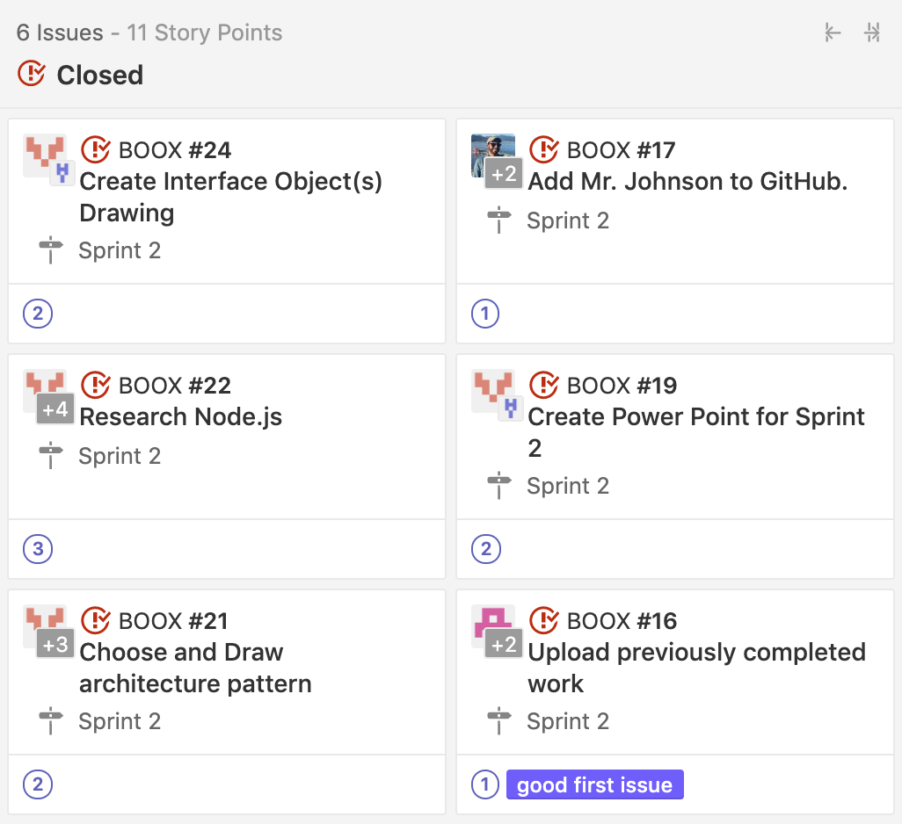
Complete Stories
We completed most of our stories.
Notes:
Jonny - Originally we included creating the front page for the website but moved that to sprint 3 upon realization that it wasn’t possible given the time constraints due to focusing on the required models and features of this sprint.

Slide 7
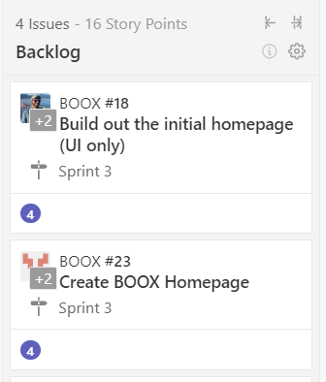
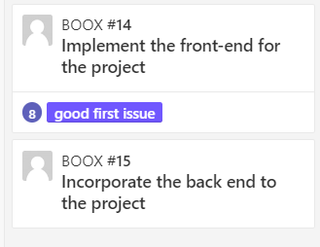
Backlog
Sprint 3 backlogs
General backlogs
Notes:
Abele -

Slide 8
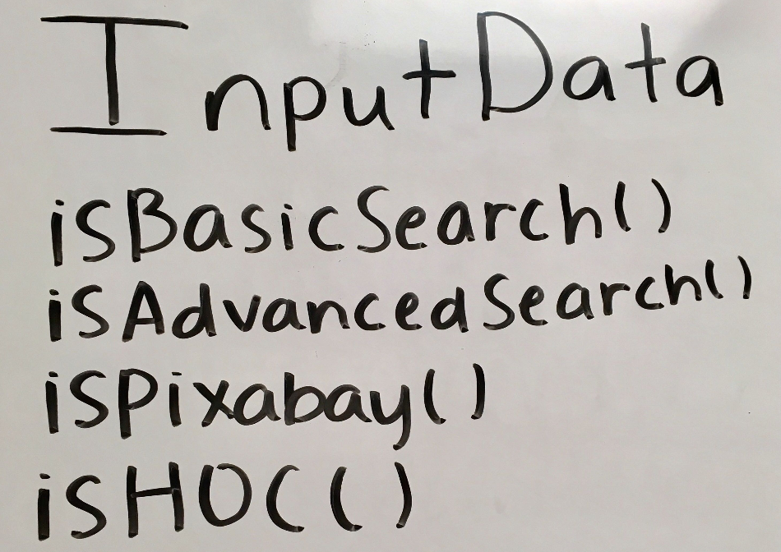
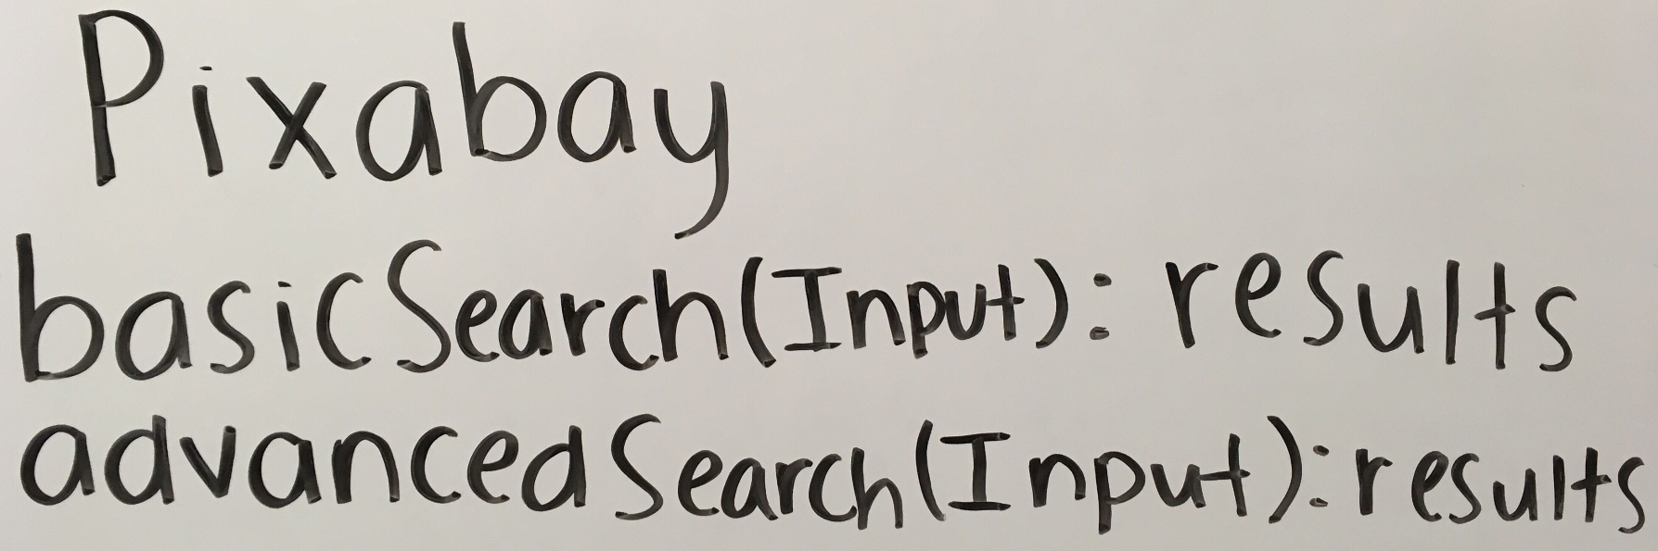
Interface Models
Notes:
Jonny -

Slide 9
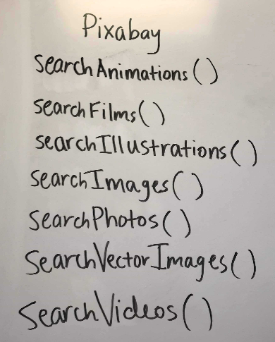
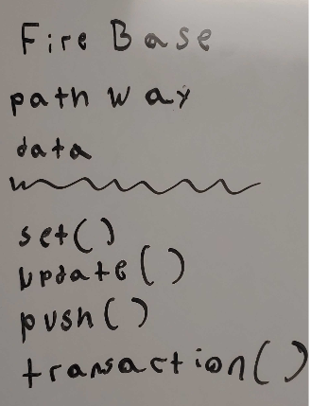
Object Models
Notes:
Jonny -

Slide 10
Architecture Pattern
Model, View, Controller Pattern
Model - contains core functionality, defines essential components.
View - any representation of information such as a chart, diagram or table.
Controller - accepts input and converts it to commands for the model or view.
Notes:
Abele - Model view controller is the most ideal

Slide 11
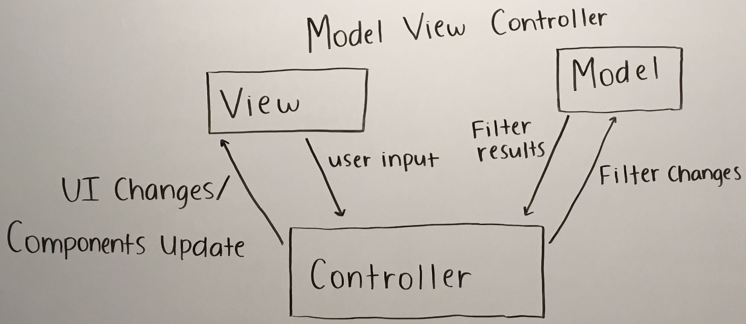
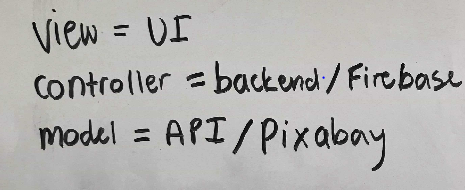
Model View Controller
Notes:
Abele -

Slide 12
Thank you!

